Slide 1
I/O Systems

Slide 2
Modern computers use various types of I/O devices. The devices are used in different environments and designing interfaces to these devices is very difficult. These devices are managed by special software called device drivers.
The functions of the I/O systems are to manage variety of device drivers, to schedule I/O requests to devices, to allocate devices to requesting processes, to match the speed of the I/O devices with CPU/Memory using buffering /caching data etc.

Slide 3
The I/O subsystem is treated as an independent unit in the computer
The CPU initiates I/O commands generically
Read, write, scan, etc
This simplifies the CPU
I/O modules are components that connect an I/O device to the I/O bus
The I/O module is an intermediary between CPU and the I/O device, and possibly between memory and the I/O device
This allows us to tailor I/O devices to specific uses without having to worry about how the CPU might be able to handle that new type of device
In addition, while the CPU may initiate an I/O operation, once begun, the I/O module takes over so that the CPU can get back to doing whatever it was doing

Slide 4
I/O subsystem will typically include
Blocks of memory dedicated to I/O buffering
I/O bus(es)
I/O devices
Specialized interfaces (for instance for keyboard and monitor) and interface cards
Possibly other connections (network, cable, etc)

Slide 5
Main tasks of I/O system:
Present logical (abstract) view of devices
Hide details of hardware interface
Hide error handling
Facilitate efficient use
Overlap CPU and I/O
Support sharing of devices
Protection when device is shared (disk)
Scheduling when exclusive access needed (printer)

Slide 6
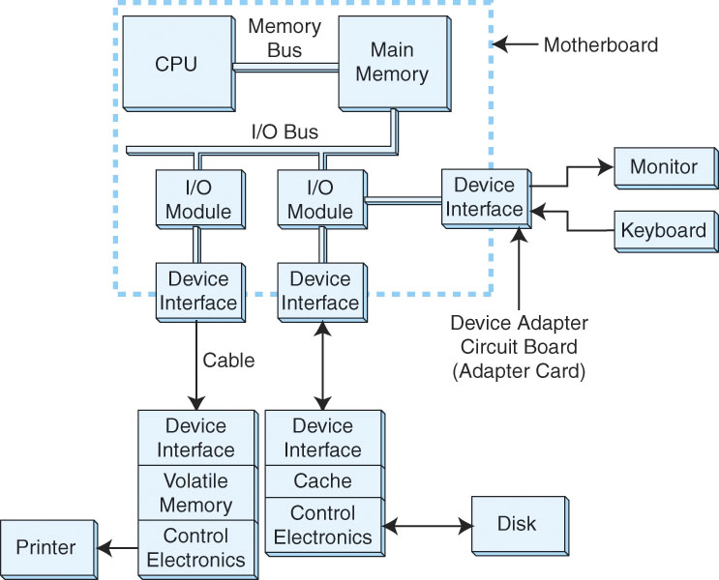
I/O Architectures

Slide 7
I/O Hardware
Any I/O device is hosted by one and only one I/O bus which is the data path connecting the CPU and an I/O device.
I/O bus is connected to an I/O device by a hierarchy of hardware components, including I/O ports, interfaces, and device controllers.

Slide 8
An I/O controller is a peripheral device that enables the main processor to transfer data between the host system and the I/O devices.
It is a special purpose processor and carries out I/O operations in parallel with CPU execution of programs.
The CPU interacts with an I/O controller through a set of controller interface registers called I/O ports.
The ports constitute the I/O address space of a controller and I/O address spaces of all I/O controllers together constitute the I/O address space of the computer system.

Slide 9
I/O ports are classified into four groups: Command, Status, Input and Output.
Command and status registers are used to start and stop all devices connected to the controller, to initialize them and to diagnose any problems encountered with them.

Slide 10
The steps to start an I/O operation:
1. CPU gives appropriate commands to ports and input data to Input ports.
2. Controller executes the command and writes back the command execution status to the status ports and output data to output ports.
3. CPU reads the status and output ports respectively to find the command completion status and the output produced.

Slide 11
The devices have different physical organizations with various physical characteristics such as the recording medium, storage capacity, interface operations and the access speed.
Examples of I/O devices are disks, tapes, CDs, printers, network interface cards, keyboards, monitors etc.
Some devices are purely input devices like keyboard, some are purely output devices like monitors and some are both like disks.

Slide 12
Classification of devices
Human readable
Machine readable
Communication

Slide 13
Categories of I/O Devices
Human readable
Used to communicate with the user
Printers
Video display terminals
Display
Keyboard
Mouse

Slide 14
Categories of I/O Devices
Machine readable
Used to communicate with electronic equipment
Disk and tape drives
Sensors
Controllers
Actuators

Slide 15
Categories of I/O Devices
Communication
Used to communicate with remote devices
Digital line drivers
Modems

Slide 16
Another way of classifying I/O devices based on the nature of their function is
Storage devices - Data are stored persistently
Communication devices - Data are transferred from one hardware component to another.

Slide 17
The devices may also be categorized based on the physical attributes:
Character or Block: A device may transfer one character/byte or one block (multiple bytes) of data at a time. Byte is smallest unit of data transfer for a character device and fixed block size is the smallest unit for a block device.
Read-only, write-only or read-write: Some devices such as keyboards allow the system to read characters whereas printers are write-only which allow system to perform write operation; Devices such as disks allow the system to load as well as store data.

Slide 18
Speed: Some devices such as keyboards have very low transferring speed (in terms of bytes per second) and some devices are faster like Ethernet cards that transfer millions of bytes per second.
Transient or durable: Transient devices store data for shorter duration as in Ethernet cards where as disks store persistent data.
Sharable or exclusive: Some devices such as disks are sharable and can be accessed by processes concurrently. Some devices are exclusive in nature like Graphical plotters.

Slide 19
Access pattern:
Sequential access devices: Data blocks are only accessible in a sequential order. e.g. Tape devices
Direct access devices: Any data block is directly accessible in any arbitrary order by providing its position. e.g. Disks
Random access devices: Data block are directly accessible but the access time is independent of the position of data. e.g. Flash devices.

Slide 20
Differences in I/O Devices
Data rate
May be differences of several orders of magnitude between the data transfer rates
Application
Disk used to store files requires file management software
Disk used to store virtual memory pages needs special hardware and software to support it
Terminal used by system administrator may have a higher priority
Complexity of control
Unit of transfer
Data may be transferred as a stream of bytes for a terminal or in larger blocks for a disk
Data representation
Encoding schemes
Error conditions
Devices respond to errors differently

Slide 21
I/O Buffering
Reasons for buffering
Processes must wait for I/O to complete before proceeding
Certain pages must remain in main memory during I/O

Slide 22
I/O Buffering
Block-oriented
Information is stored in fixed sized blocks
Transfers are made a block at a time
Used for disks and tapes
Stream-oriented
Transfer information as a stream of bytes
Used for terminals, printers, communication ports, mouse and other pointing devices, and most other devices that are not secondary storage

Slide 23
Single Buffer
Operating system assigns a buffer in main memory for an I/O request
Block-oriented
Input transfers made to buffer
Block moved to user space when needed
Another block is moved into the buffer
Read ahead
User process can process one block of data while next block is read in
Swapping can occur since input is taking place in system memory, not user memory
Operating system keeps track of assignment of system buffers to user processes

Slide 24
Single Buffer
Stream-oriented
Used a line at time
User input from a terminal is one line at a time with carriage return signaling the end of the line
Output to the terminal is one line at a time

Slide 25
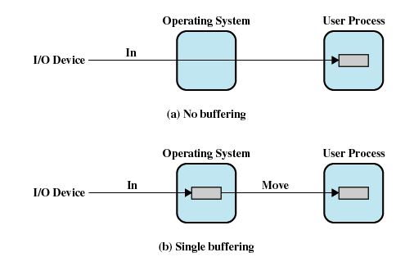
I/O Buffering

Slide 26
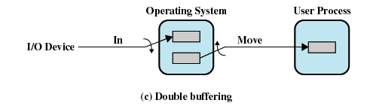
Double Buffer
Use two system buffers instead of one
A process can transfer data to or from one buffer while the operating system empties or fills the other buffer

Slide 27
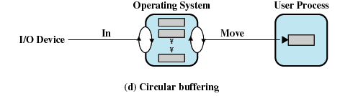
Circular Buffer
More than two buffers are used
Each individual buffer is one unit in a circular buffer
Used when I/O operation must keep up with process

